Slide 1
WallPlan: Synthesizing Floorplans by Learning to Generate Wall Graphs
Jiahui Sun¹ Wenming Wu¹ Ligang Liu²
Wenjie Min¹ Gaofeng Zhang¹ Liping Zheng¹
¹Hefei University of Technology
²University of Science and Technology of China
Notes:
Hello everyone.
I am Jiahui Sun and I am presenting our work titled “Wallplan: Synthesizing Floorplans by Learning to Generate Wall Graphs”.
It is joint work between Hefei University of Technology and University of Science and Technology of China.

Slide 2
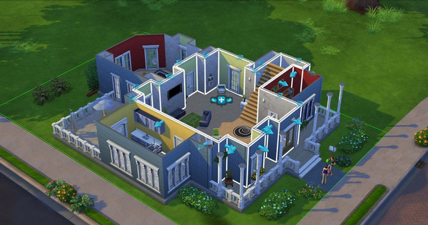
Interior plan
Interior Design
Video game
Notes:
In video games and virtual realities, indoor scenes are well designed for people to explore and interact with.
A floorplan is a simplified representation of the layout of interior space. The vectorized floorplan lay the foundation for indoor scene modeling. So there is a significant demand for floorplans in the field of interior design and video games.

Slide 3
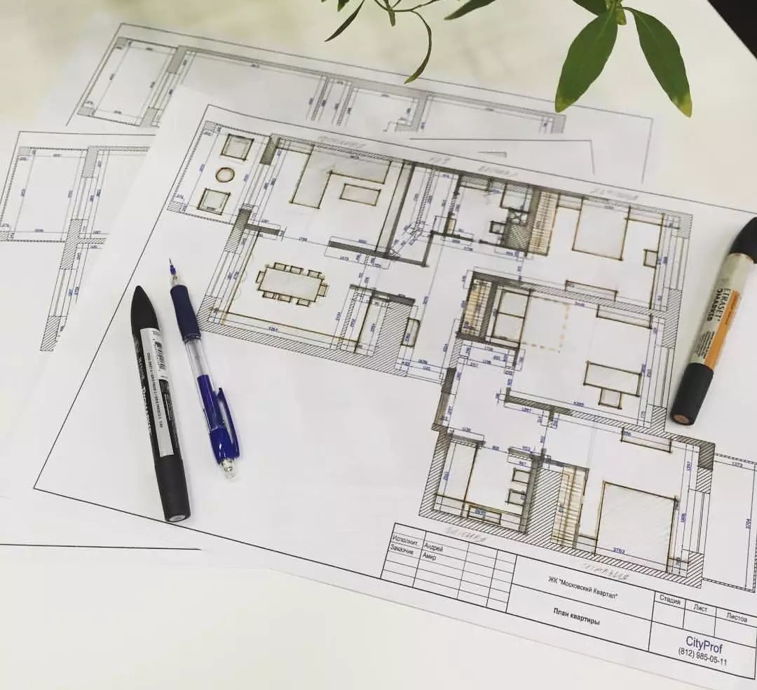
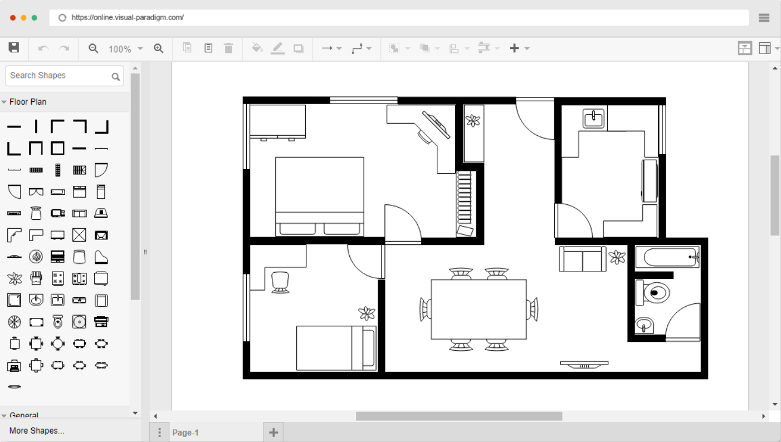
Motivation
Hand-designed
Tool-designed
Notes:
In the past, interior floor plans are created by hand or tools. Even though, the design process is time-consuming with trial-and-error.

Slide 4
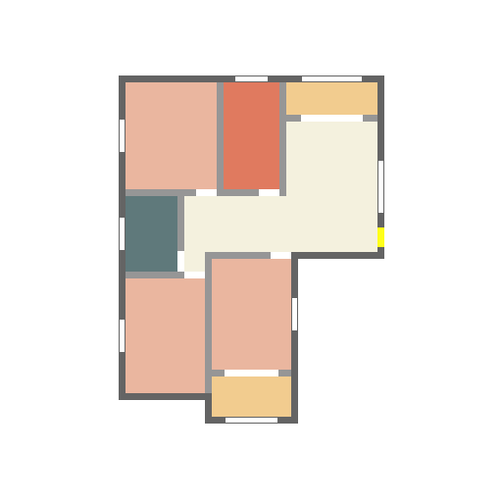
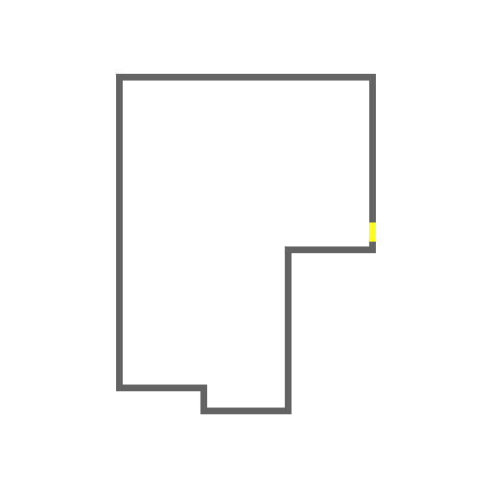
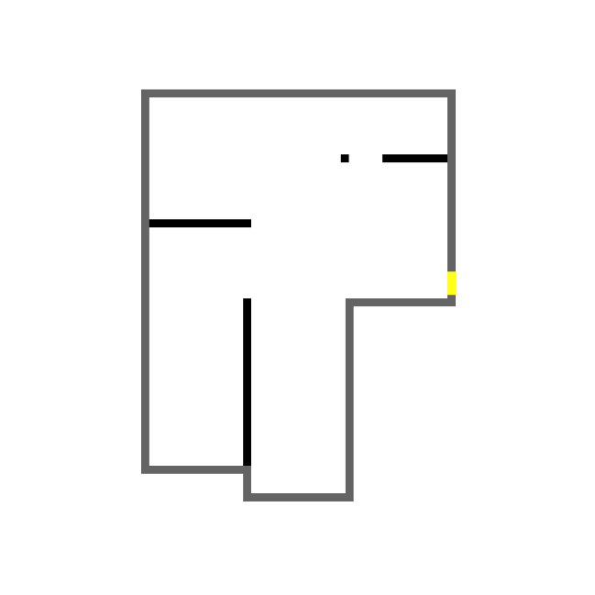
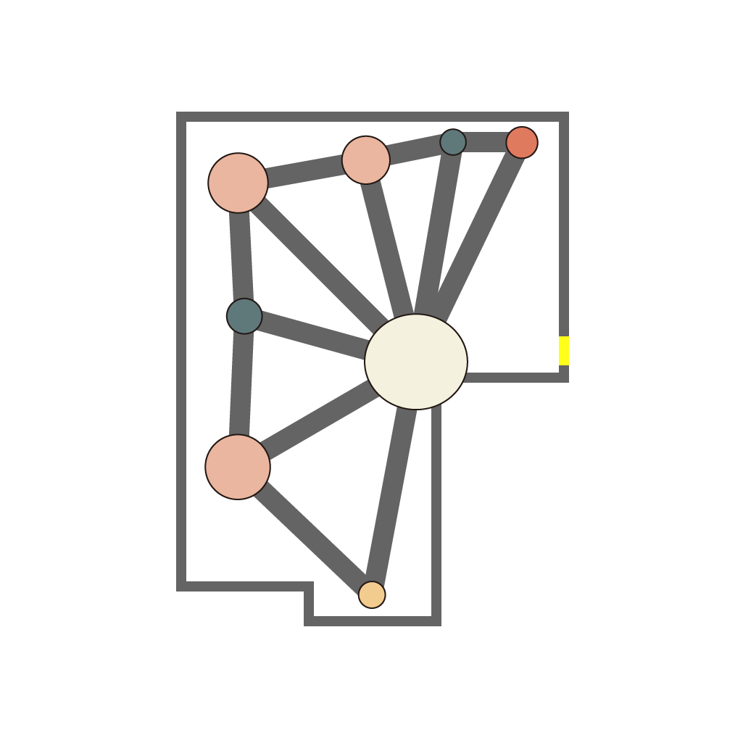
Goal
Automate design for vectorized floorplans
Supporting for different design constraints
Notes:
To design floorplans more efficiently, our goal is to automatically generate vectorized floorplans.
We also want to support different design constraints such as boundaries, loading-bearing walls, and bubble diagrams.

Slide 5
Existing methods
Dataset
Network
Notes:
In recent years, a number of learning-based approaches have attempted to address this problem by implicitly learning the principles of floorplan design.
Learning-based approaches show great advantages compared with traditional optimization-based generation methods, which need careful constraint setting and modeling.

Slide 6
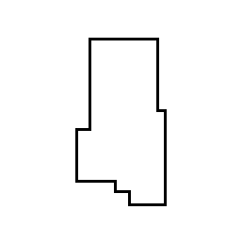
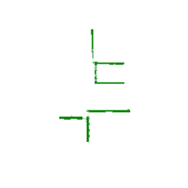
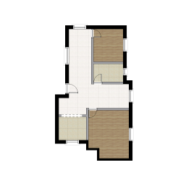
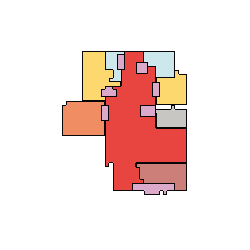
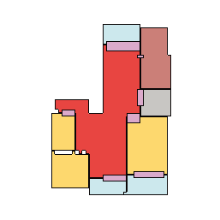
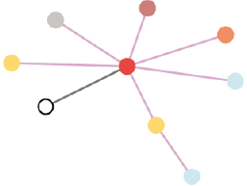
Pixel level methods
RPLAN [Wu et al. 2019]
House-GAN++ [Nauata et al. 2021]
Notes:
Some learning-based methods predict labels of floorplan elements at the pixel level.
RPLAN presents a two-stage convolutional neural network for automatically generating floorplans by locating rooms first and then locating walls.
House-GAN++ presents a generative model for diverse floorplans from the bubble diagrams.
For pixel-level methods, as the output floorplans are represented in raster images, further post-processing is still needed to get the final vectorized floorplans.

Slide 7
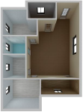
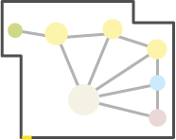
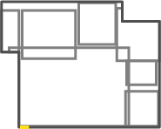
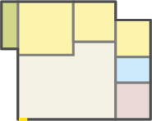
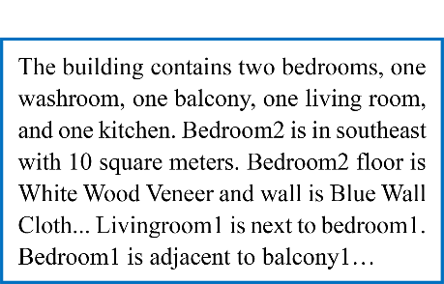
Box level methods
Graph2Plan [Hu et al. 2020]
Text2Plan [Chen et al. 2020]
Notes:
Some learning-based methods are to predict the bounding boxes of rooms at the box level.
Graph2Plan achieves the conversion of bubble diagrams to floorplans by deep network frameworks and the bubble diagrams are retrieved according to the similarity of boundaries.
Text2Plan focus on producing floorplans from language descriptions that describe house details based on graph convolutional network and generative adversarial network.
For the box level method, the generated box is also discrete, so the subsequent optimization is essential. Moreover, they can only generate rooms in the representation of rectangular, which reduces the rationality of results.

Slide 8
Method
Notes:
Now I will present our method for floorplan generation.

Slide 9
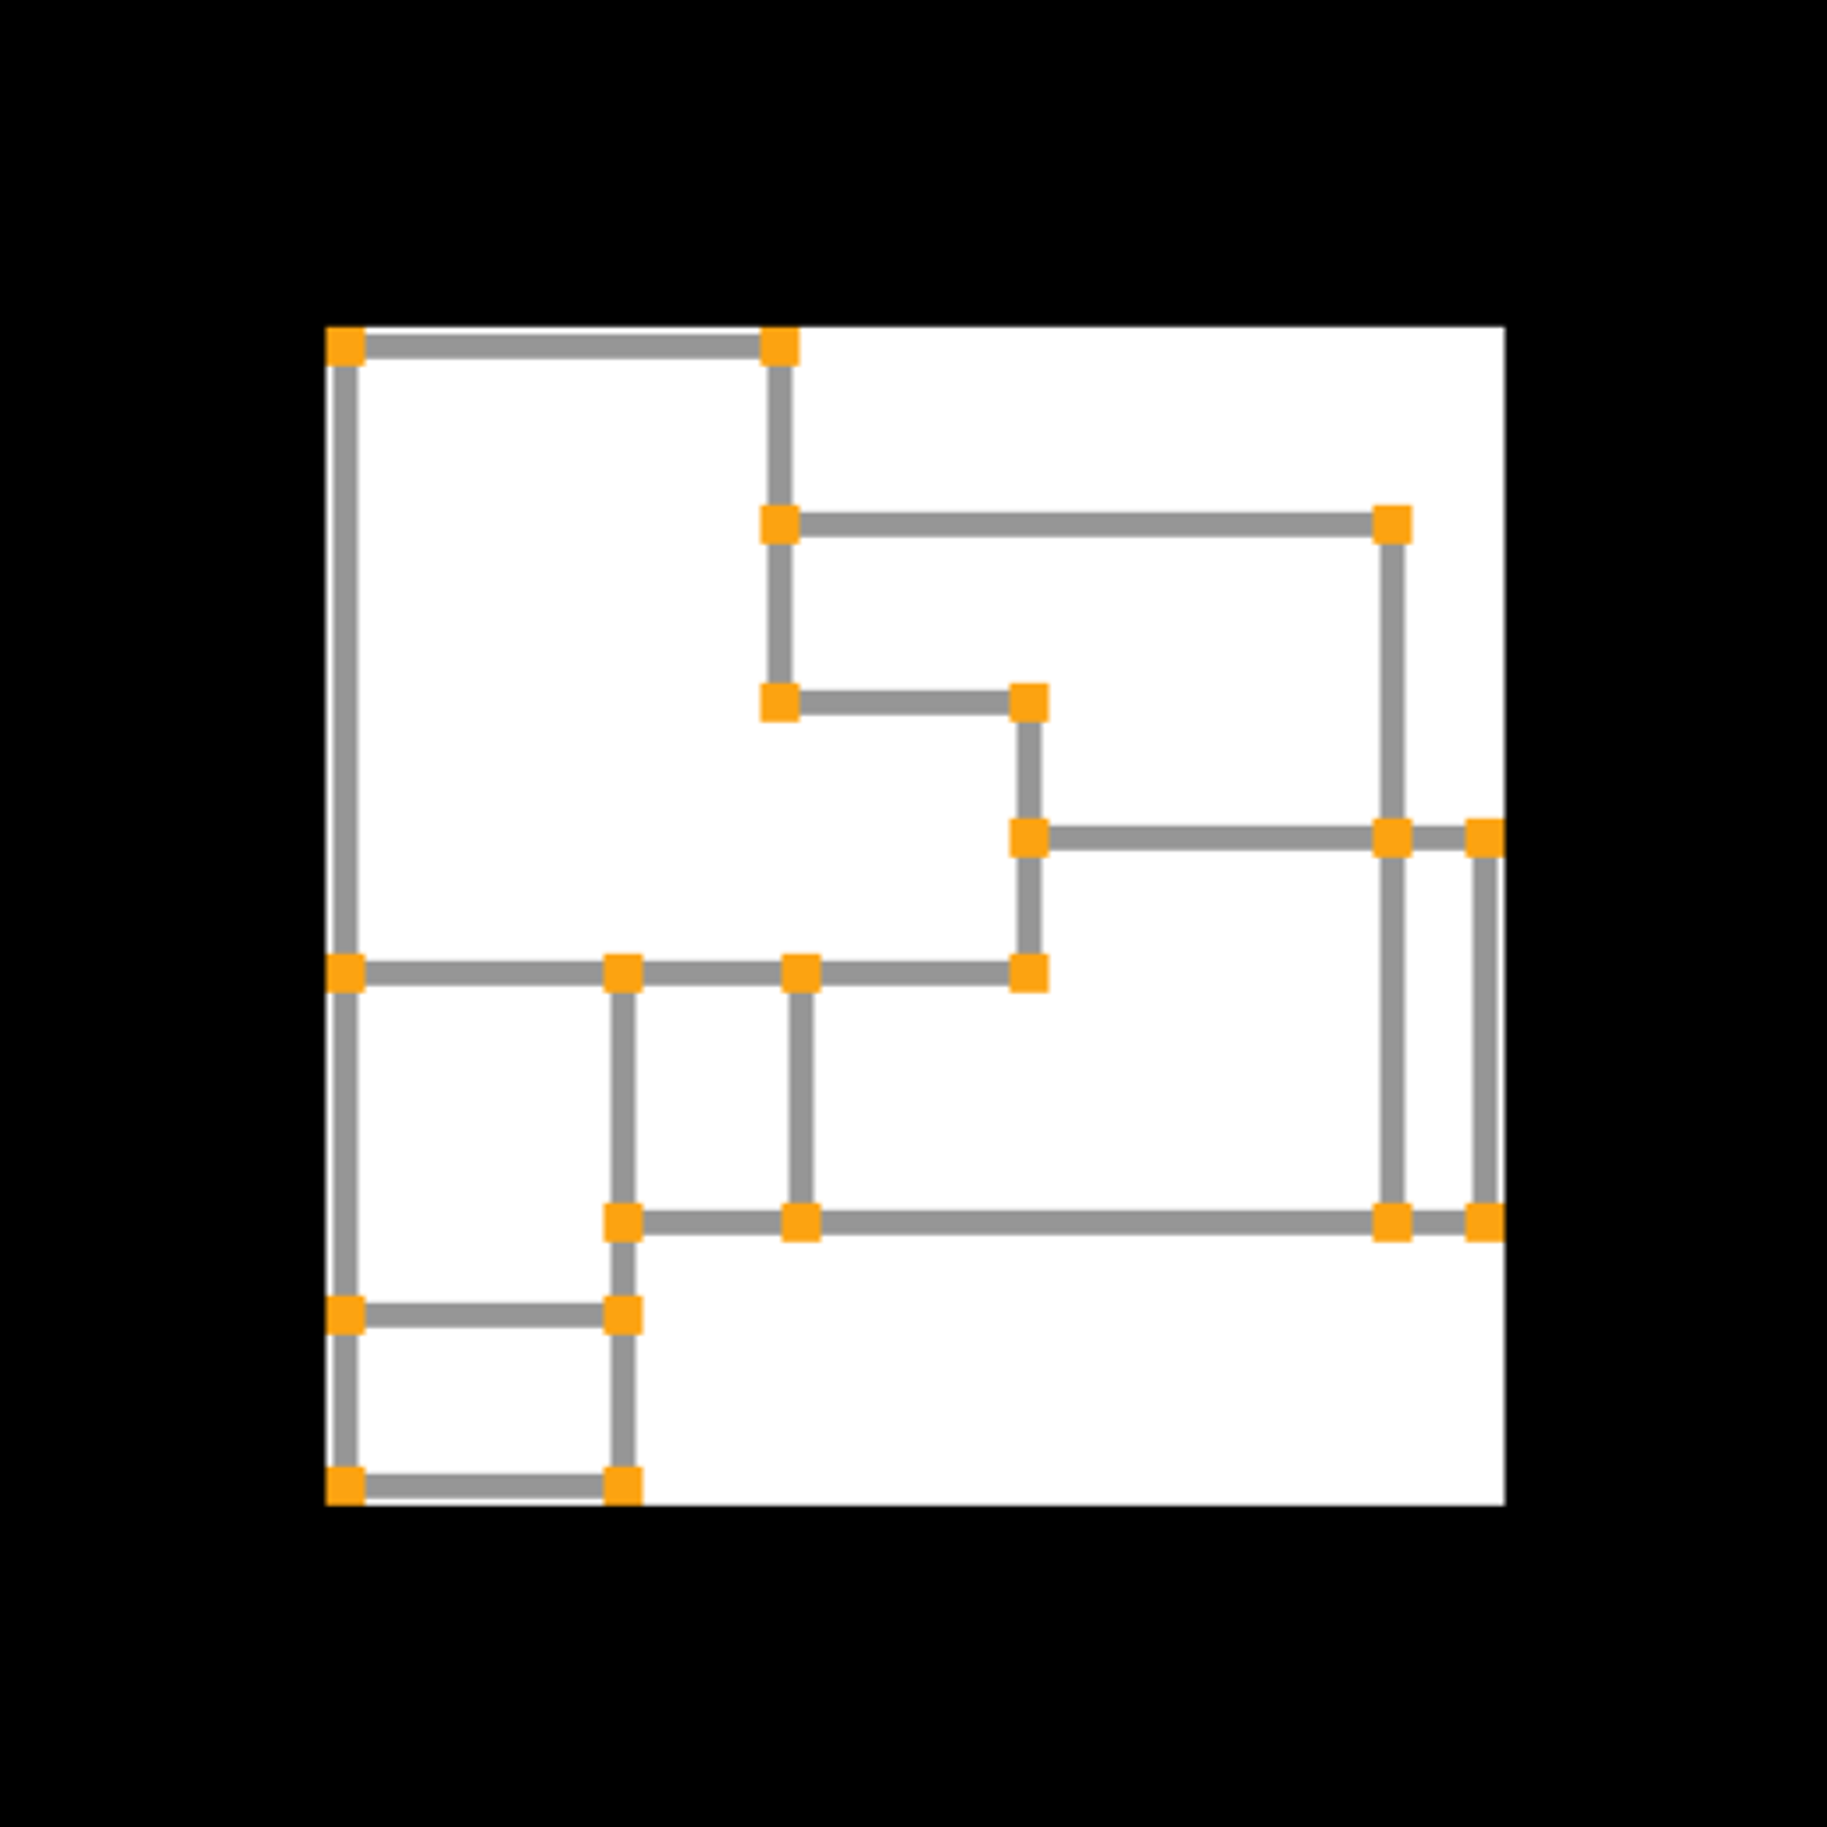
Floorplan representation
$$Lk:\{ \}$$
$$G=(V,ℰ)$$
Bedroom
Living room
$$ℰ=\left\{\left(vi,vj\right)|vi,vj∈V\right\}$$
$$(vi,vj)$$
$$vk=(Pk,Lk)$$
$$vi$$
$$vj$$
$$Rl$$
Notes:
We first present a novel floorplan representation.
We represent the floorplan in the original RPLAN dataset as a wall graph.
The wall graph contains a node set indicating wall junctions and a edge set indicating wall segments.
The nodes in the wall graph have position and label information.
A shortest cycle forms the room, which is the single region surrounded by nodes.

Slide 10
Our work
Input
Output
Floorplan generation
Notes:
Once adopting a wall graph to represent floorplan, the vectorized floorplan can be directly obtained from the wall graph,

Slide 11
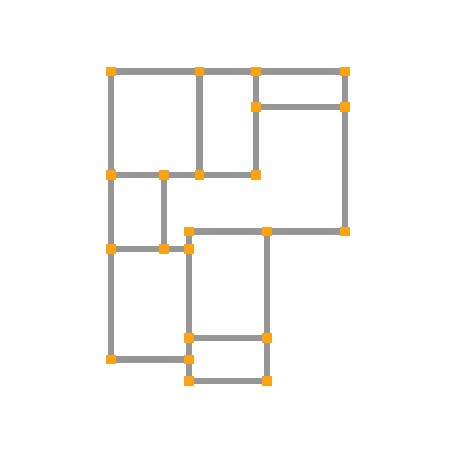
Our work
Input
Output
Graph generation
Notes:
and thus a natural idea is to transform floorplan generation to wall graph generation.

Slide 12
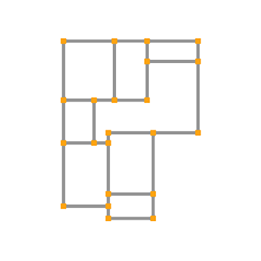
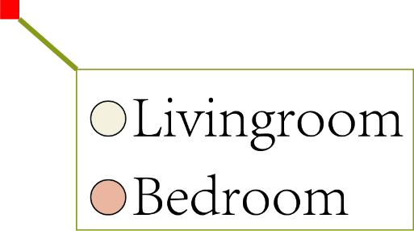
Our work 删
Notes:
We believe that a different floorplan representation could inspire a different solution.
Our key idea is to consider floorplan generation as wall graph generation.
The room labels are also added to the wall graph to complete the floorplan information.

Slide 13
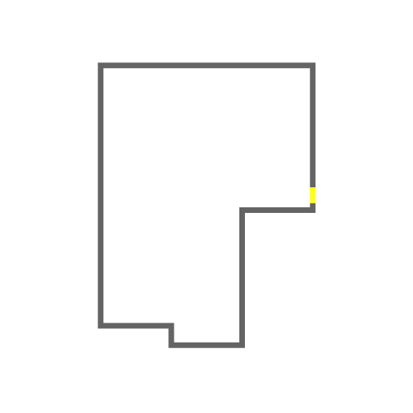
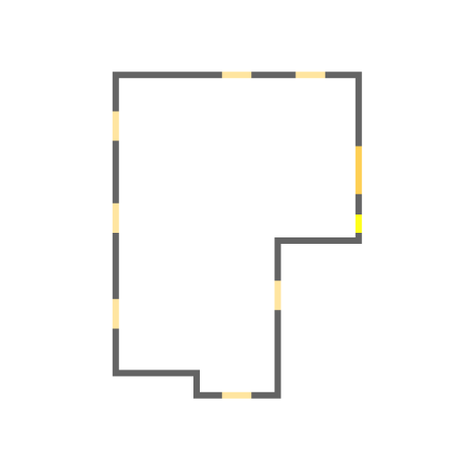
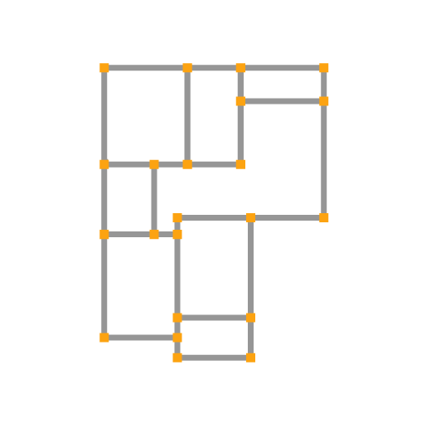
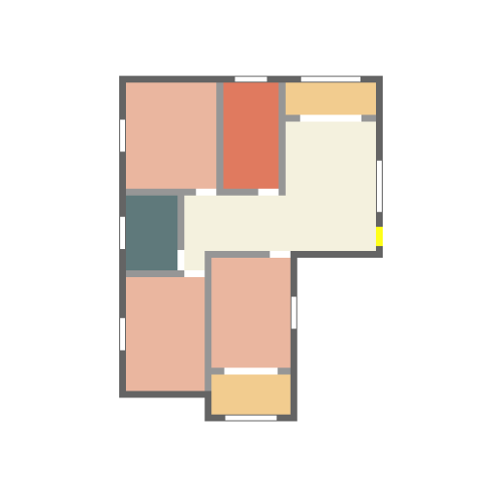
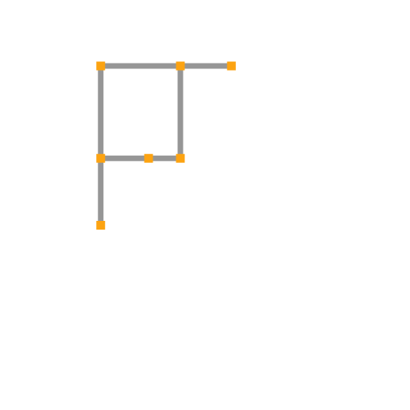
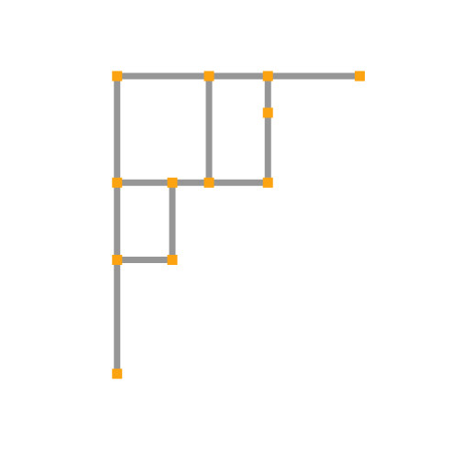
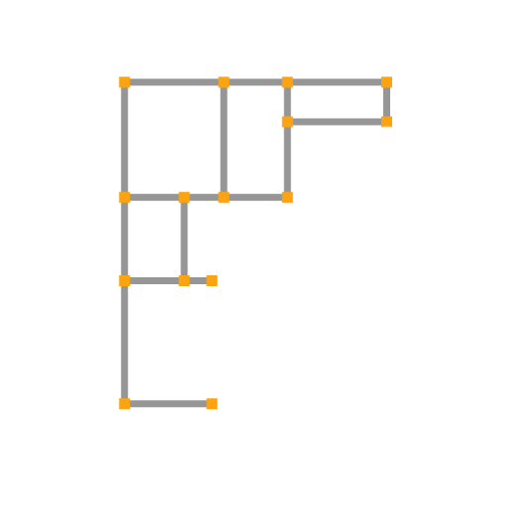
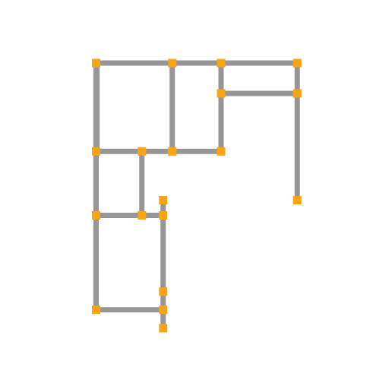
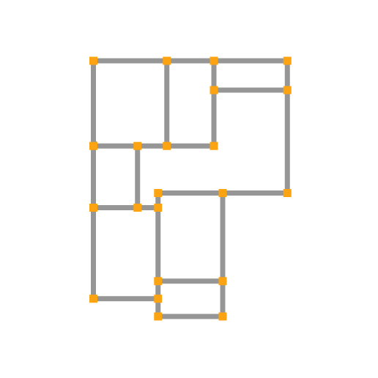
Overview of WallPlan
GraphNet
LabelNet
WinNet
Notes:
We propose a novel wall-oriented method, called WallPlan, for automatically and efficiently generating plausible floorplans.
Given the boundary as input, we first initialize the boundary with windows which can be predicted by WinNet.
Starting from one node of the boundary, we propose a graph generation network GraphNet to iteratively predict new nodes and edges in a manner of graph traversal.
The wall graph is progressively generated constrained on the boundary as well as other design constraints by feeding the inputs to GraphNet.
To obtain room labels, we propose a semantics prediction network LabelNet to obtain the global floorplan semantics from the generated wall graph.
GraphNet and LabelNet are coupled to generate a wall graph with room labels progressively. This repeats until a complete wall graph can be obtained.

Slide 14
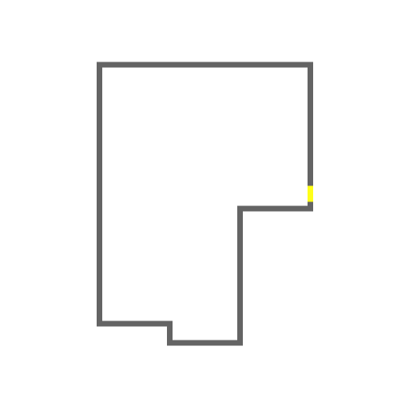
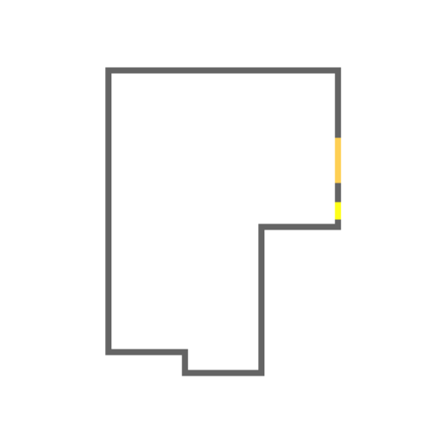
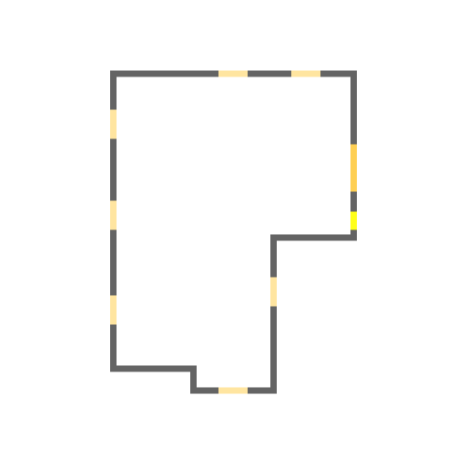
Window initialization
WinNet
WinNet
Notes:
Now we show the first step of Wallplan, window initialization.
Given the input boundary, we first predict the living room window, which is bigger than others. Then the windows of other type rooms are predicted based on the boundary and the predicted living room window.
The window-first strategy brings two benefits. On one hand, windows can serve as a soft constraint to limit the solution space of floorplan design, improving the overall rationality of generated floorplans. On the other hand, the distribution of windows can guide floorplan generation, providing a degree of control over the generative process.

Slide 15
GraphNet
$$=\prod_{t=0}^{T}{P\left(∆Vt+1,∆ℰt+1|Gt,B\right)}$$
$$P\left(ℰT | ℬ\right)$$
$$=P\left(VT,ℰT | ℬ\right)$$
$$Gt+1=Gt∪\left(∆Vt+1,∆ℰt+1\right)$$
Notes:
Given the boundary which can be represented as a polygon B, our goal is to generate a wall graph G = (V, E) constrained on B.
Starting from one node of the boundary, we propose a graph generation network GraphNet to iteratively predict new nodes and edges in a manner of graph traversal.
Supposing that G(t) is the wall graph in the t-iteration, the new nodes and edges of the wall graph G(t+1) can be predicted from the wall graph G and the boundary B. The joint distribution of G can be constructed by the chain rule.
Without loss of generality, we first choose the top-left node of the boundary as the starting point. Then an iterative pipeline is following. In each step, GraphNet is used to produce the candidates of new nodes and edges by taking the input boundary, wall graph, and source nodes as input.

Slide 16
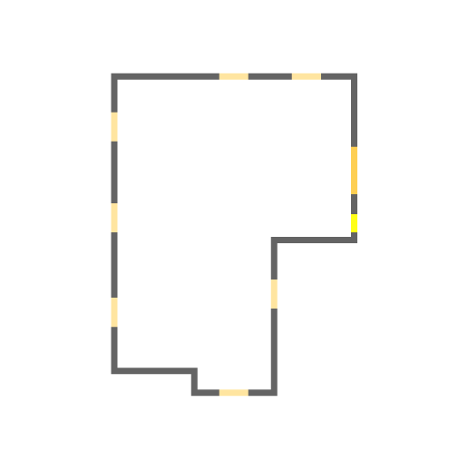
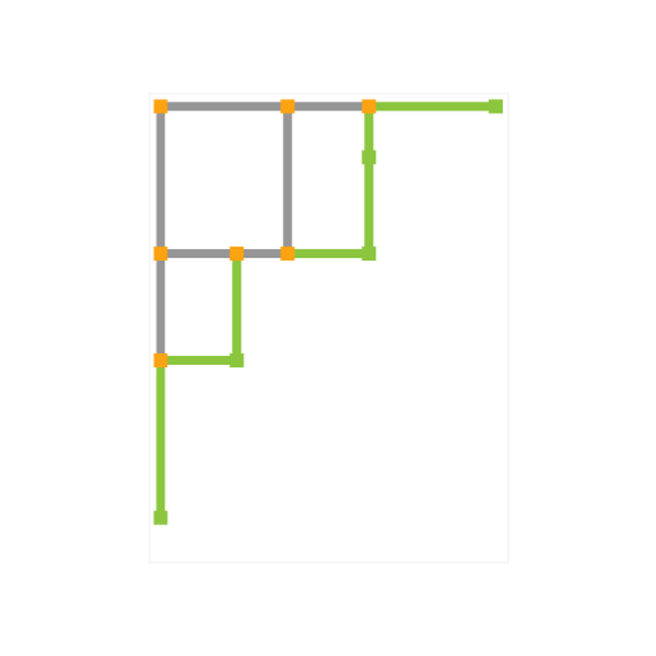
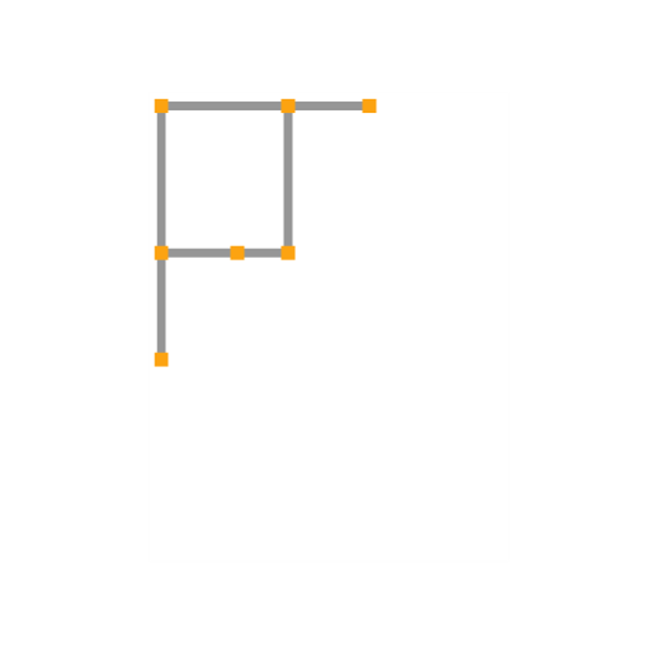
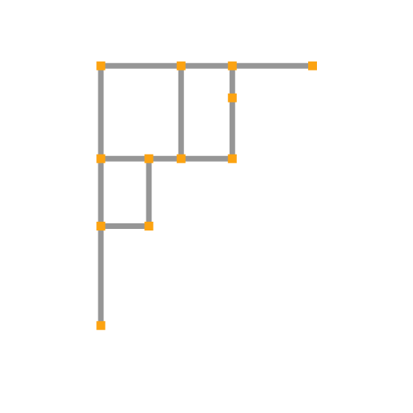
GraphNet
Notes:
Here we show one step of the wall graph generation. Given the boundary and wall graph, GraphNet outputs the semantic segmentation of the new nodes and edges, and we further extract new nodes and edges to construct a new wall graph.

Slide 17
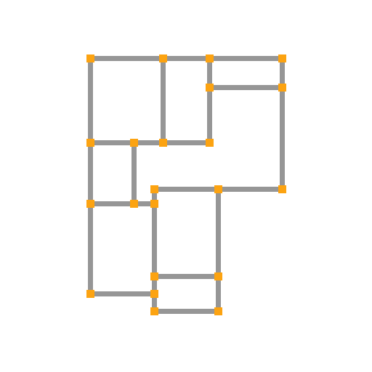
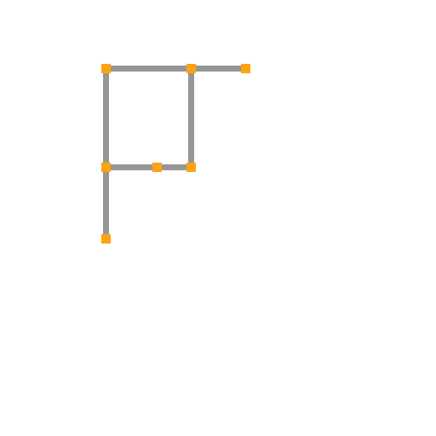
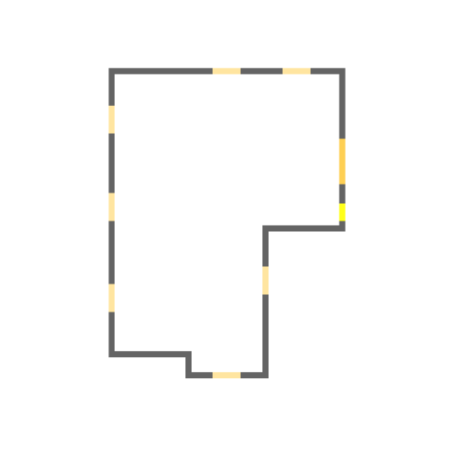
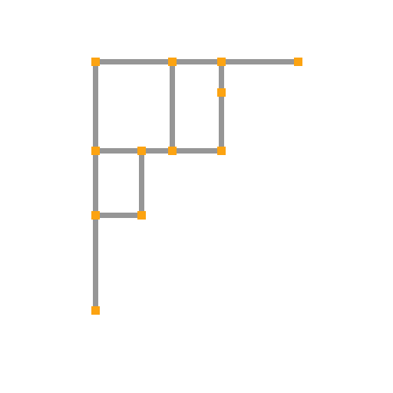
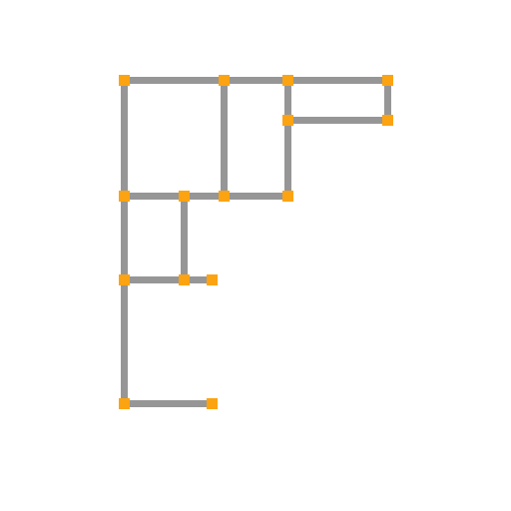
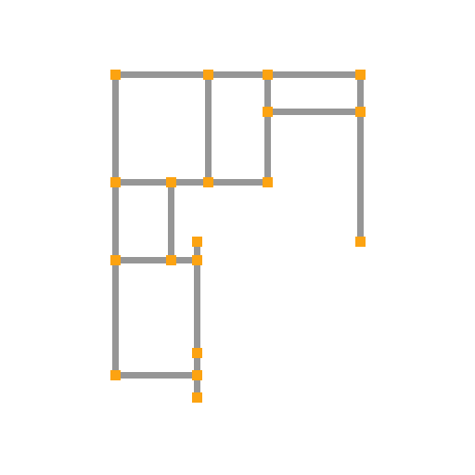
LabelNet
Notes:
In addition to the wall graph structure, we need to assign room labels for each node in the generated wall graph.
Therefore, we propose a semantics prediction network called LabelNet to obtain the global floorplan semantics from the generated wall graph.
The input wall graph to LabelNet is not necessarily the complete graph presented as a multi-channel images. As we can see, the semantic generation results become more and more accury as the wall graph structure information is completed.

Slide 18
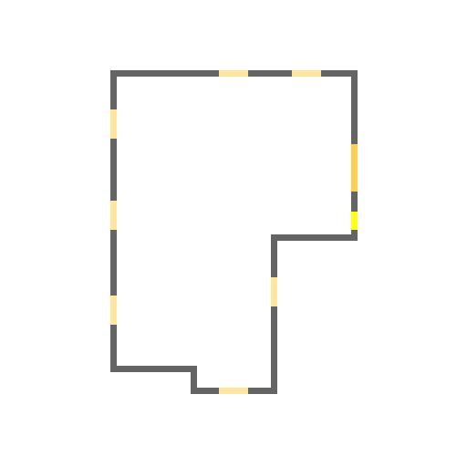
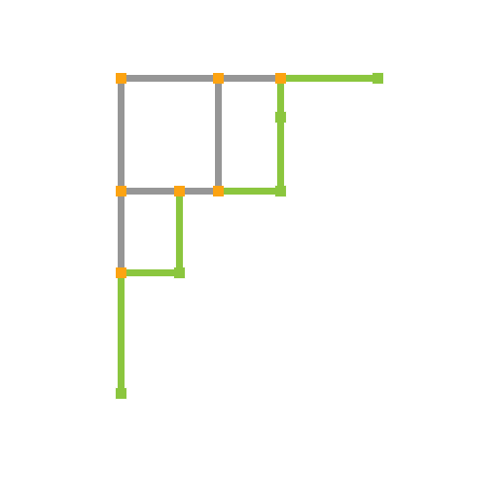
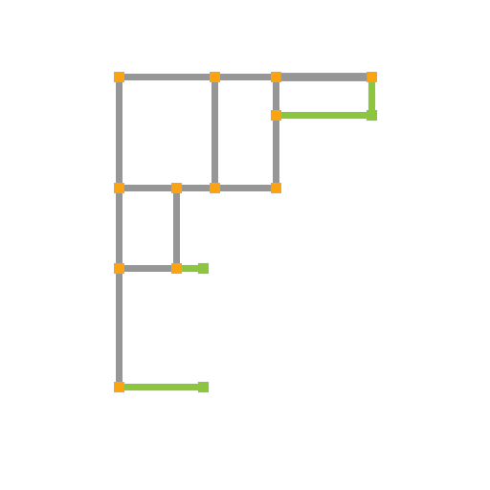
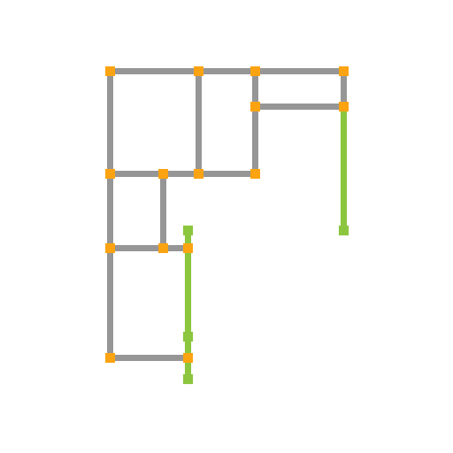
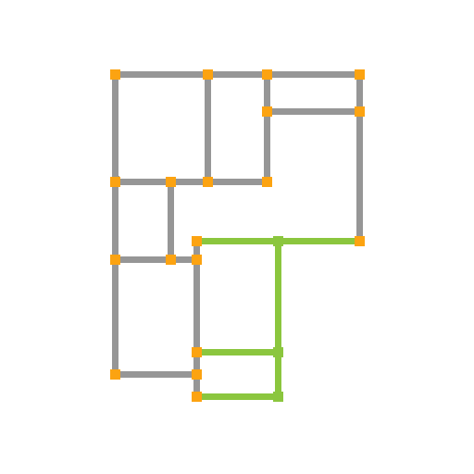
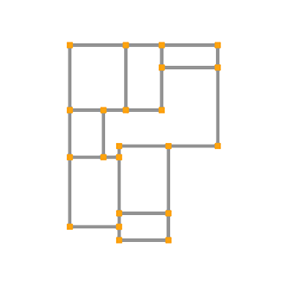
Coupled structure
GraphNet
LabelNet
Notes:
So far, we have proposed two modules: GraphNet and LabelNet.
In the following, we do not simply chain these two modules together to construct a wall graph with room labels. What we want is to deeply couple the wall graph generation and room label prediction to improve the overall quality of the wall graph.
The wall graph generated by GraphNet will be used for room label prediction, and the result of the LabelNet will, in turn, assist wall graph generation by adding to the GraphNet’s inputs.
In this way, the room label prediction and wall graph generation are coupled to generate a wall graph with room labels.

Slide 19
Coupled structure
LabelNet
GraphNet
Notes:
Here we show the network architecture of the coupled structure.
The boundary is the initial input. Given a wall graph and the input boundary, LabelNet is used to predict the global floorplan semantics.
Then GraphNet is used to produce a new wall graph from the wall graph, input boundary as well as the floorplan semantics.
This can be executed repeatedly until a complete wall graph can be obtained.

Slide 20
Constrained generation
WallPlan
Visualizing
Bubble diagram
Loading-bearing wall
Boundary
Window
Hybrid
$$P\left(GT | B,D\right)=\prod_{t=0}^{T}{P\left(∆Vt+1,∆ℰt+1|Gt,B,D\right)}$$
$$P\left(GT | B\right)=\prod_{t=0}^{T}{P\left(∆Vt+1,∆ℰt+1|Gt,B\right)}$$
$$P\left(GT | B,W\right)=\prod_{t=0}^{T}{p\left(∆Vt+1,∆ℰt+1|Gt,B,W\right)}$$
$$P\left(GT | B,W,D\right)=\prod_{t=0}^{T}{P\left(∆Vt+1,∆ℰt+1|Gt,B,W,D\right)}$$
Notes:
By adding additional input constraints, WallPlan can generate diverse floorplans.
Such as:
The only boundary constraint
The window constraint
The load-bearing wall constraint The bubble diagram constraint
The hybrid-constraint
As our method WallPlan is actually a wall-oriented method, it is rather natural to realize various constraints.

Slide 21
Experiments
Notes:
Now I will show the experiments and results of our method.

Slide 22
Ablation study
Notes:
In WallPlan, we introduce two core modules, WinNet and the coupled structure of GraphNet and LabelNet.
For the ablation study of WinNet, we take it away from WallPlan and for the ablation study of coupled structure, we directly decouple the original coupled structure into a two-stage network, first generating the wall graph by GraphNet and then predicting room labels by LabelNet.
It can be clearly seen that the complete wallplan achieved better results compared to the two ablation experiments

Slide 23
Boundary constrained generation
GT
RPLAN
Graph2Plan
Ours
Notes:
Here show the comparison of the generated floorplans from boundaries. We perform comparisons with the ground truth, RPLAN and Graph2Plan.
As we can see, RPLAN generates several crumbling walls due to complex post-processing on the raster image.
Graph2Plan generates floorplans with some “tiny” rooms, especially the fourth one which the generated bathroom box is almost invisible due to the post-processing.
Our method can generally produce significantly different but still high-quality floorplans compared to the GT, with the first column being a obvious example.

Slide 24
Bubble diagram constrained generation
Input
GT
Graph2Plan
Ours
Notes:
Here show the comparison of the generated floorplans from bubble diagrams. We perform comparisons with the ground truth and Graph2Plan.
The bubble diagram is strong to constrain the connection, type, location, and size of rooms. Clearly with the bubble diagram as input, our method can generate plausible floorplans closer to the ground truth than the results of Graph2Plan. Moreover, graph2Plan cannot create the effect of deep corridors while our method enables the design of deep corridors as shown in the ground truth.
This difference is attributed to our graph structure representation, while Graph2plan can only represent simple rectangles, and subsequent alignment of the room box will make the corridors disappear.

Slide 25
Loading-bearing wall constrained generation
Input
Wall graph
Visualization
Notes:
Here show the comparison of the generated floorplans from loading-bearing walls.
We can see that the input load-bearing wall constraints are satisfied.
Similar to the bubble diagram constraint, a certain degree of control over the floorplan generation can also be realized by the loading-bearing wall constraint

Slide 26
Comparing to House-GAN++
House-GAN++ [Nauata et al. 2021]
Ours
Notes:
We also compare the floorplans generated by our method with the results by House-GAN++, even it accept only bubble diagram as the input.
To fairly compare the performance of the two methods, we adopt a drawing style similar to House-GAN++.
It shows that the quality of the generated ﬂoorplans by our method is much higher than that of House-GAN++.

Slide 27
Comparison to Hybird-Method
GT
Hybrid-Method
[Para et al. 2021]
Ours
Notes:
We compare to the hybrid-method with the same boundary.
The hybrid-method obtains the final floorplan by linear programming, therefore may produce problematic floorplans due to the optimization.

Slide 28
Generalization
Notes:
Here shows a gallery of floorplans generated from the same boundary. Our method explores diﬀerent possible settings of windows, bubble diagrams, and loading-bearing walls, and generates
varying floorplans adapting to the corresponding constraints.
It indicates the results variety and generalization of our method.

Slide 29
Interpolation test
Notes:
WallPlan can generate floorplans from a set of interpolated boundaries. The first and last ones are the input boundaries for interpolation.
As the input boundary slowly changes, the floorplan structure also changes accordingly and maintains a relatively reasonable spatial division.

Slide 30
Perceptual study
Which one do you think is more plausible in the following floorplans? If it is difficult for you to judge, choose C for “Not sure”.
Notes:
We have conducted the perceptual study to evaluate the generation quality and perceived realism of the generated floorplans.

Slide 31
Perceptual study
Voting results of five groups of perceptual studies
Notes:
Here shows the detailed voting results of five groups of perceptual studies.
The boxes show the voting of choosing our method in perceptual studies.
We can see that our method have great advantage comparing to the state-of-the-art methods.

Slide 32
Perceptual study
The violin plot of perceptual studies' results
Notes:
Here shows the violin plot of perceptual studies’ results.
The red line on 50% indicates a random guess rate given the forced-choice task.
Clearly, the results of perceptual studies verify the conclusions of the previous qualitative comparisons.

Slide 33
FID comparison
FID comparison with RPLAN and Graph2Plan
FID comparison with House-GAN++ and Hybrid-Method
Notes:
We compare to the state-of-the-art techniques using FID, which calculate the distribution similarity between the generated images and the ground truth.
The lower the FID score, the more similar the generated results to the ground truth.
The Table shows an obvious improvement in our FID score compared to all baselines.

Slide 34
Statistics comparison
Statistics comparison with RPLAN and Graph2Plan
Notes:
To improve our evaluation, statistics of the generated floorplans by diﬀerent methods are conducted to evaluate floorplan topology.
The comparison result illustrates that our method outperforms the state-of-the-art techniques in generating the topology of the floorplans.

Slide 35
Conclusion

Slide 36
Conclusion
A novel wall-oriented method to generate floorplans by representing the floorplans as a wall graph and enabling graph generation
A coupled geometry-semantics network that enables wall graph generation under various design constraints in an iterative manner of graph traversal
Notes:
In conclusion, we propose a novel wall-oriented method for automatically and efficiently generating plausible floorplans.
Diﬀerent from previous techniques, our method synthesizes floorplans by learning to generate wall graphs. This is achieved by regarding floorplan generation as wall graph generation.
A learning-based method WallPlan is proposed to generate both the local geometry of the wall and the global semantics of the floorplan by imitating the graph traversal.
Intensive experiments demonstrate that our method supports various constraint generation, producing higher quality floorplans than state-of-the-art techniques.

Slide 37
Future work
Hard constraint generation
Multiple-floorplan generation
Smarter door setting
General graph generation
More advance leaning method
End-to-end
Notes:
Despite the progress made by WallPlan, our method can be further improved in the future work, such as hard constraint generation, multiple-floorplan generation, smarter door setting, general graph generation, and more advance leaning method for end-to-end generation.
In the future, we would like to extend the scope and capabilities of our graph-based generative method.

Slide 38
Acknowledgements
All participants of perceptual studies
Wamiq Para [Para et al.2021], KAUST
All anonymous reviewers
All funding agencies
Notes:
We would like to thank all perceptual study participants for evaluating our results, Wamiq Para for providing their implementation, all the anonymous reviewers for their constructive suggestions and comments.
And all funding agencies for their contribution to this project.

Slide 39
Thank you
Jiahui Sun
Notes:
Thanks for your attention.

